Slide 1


Han, Sijia
July 26, 2024
GitHub

Slide 2

Outline
Executive Summary
Introduction
Methodology
Results
Conclusion

Slide 3
Executive Summary
Summary of methodologies
Data Collections
Data Wrangling
Exploratory Data Analysis
Interactive Visual Analytics
Machine Learning Prediction Analysis
Summary of all results
Launch success has improved over time.
KSC LC-39A has the highest success rate among landing sites.
Orbits ES-L1, GEO, HEO, and SSO have a 100% success rate.
Most launch sites are near the equator, and all are close to the coast.
All models performed similarly on the test set. The decision tree model slightly outperformed.

Slide 4
Introduction
Project background and context
SpaceX, a trailblazer in the space industry, is committed to making space travel accessible and affordable for everyone. Its remarkable achievements include sending spacecraft to the International Space Station, launching a satellite constellation to provide global internet access, and conducting manned missions to space. SpaceX's success largely stems from its innovative reuse of the first stage of its Falcon 9 rocket, which significantly reduces launch costs to approximately $62 million per launch. In contrast, other providers who do not have the capability to reuse the first stage face costs upwards of $165 million per launch. By determining the likelihood of a successful first-stage landing, we can estimate the launch price. Public data and machine learning models can be utilized to predict whether SpaceX or a competing company can reuse the first stage, thereby impacting overall costs.
Problems we want to find answers
How payload mass, launch site, number of flights, and orbits affect first-stage landing success
Rate of successful landings over time
Best predictive model for successful landing (binary classification)

Slide 5

Section 1

Slide 6
Methodology
Executive Summary
Data collection methodology:
Using SpaceX REST API and web scraping techniques
Perform data wrangling
Filtering the data, handling missing values and applying one hot encoding
Perform exploratory data analysis (EDA) using visualization and SQL
Perform interactive visual analytics using Folium and Plotly Dash
Perform predictive analysis using classification models
Predict landing outcomes using classification models.
Tune and evaluate models to find the best model and parameters.

Slide 7
Data Collection – SpaceX REST API
Using the SpaceX REST API to retrieve data about launches, including information about the rocket used, payload, launch specifications, landing specifications and landing outcomes.
Steps
Request the SpaceX launch data using the GET request.
Decode response content as a JSON and convert it to a Pandas dataframe.
Use the API to request information about launches and retrieve data on rockets, payloads, launchpads, and cores.
Create a Pandas dataframe to store all the data.

Slide 8
Data Collection – Web Scraping
Web scrapping to collect Falcon 9 historical launch records from a Wikipedia page titled List of Falcon 9 and Falcon Heavy launches.
Steps
Request Falcon 9 launch Wiki page from its URL using the HTTP GET method.
Create a BeautifulSoup object from the HTML response.
Extract all column/variable names from the HTML table header.
Create a Pandas dataframe by parsing the launch HTML tables.

Slide 9
Data Wrangling
Data obtained from APIs or web scraping is often imperfect and requires thorough cleaning before further exploration. Additionally, performing an initial data analysis is crucial to gain insight into the gathered data, allowing us to better understand the variables and their relationships.
Steps
Dealing with the missing values – using mean() to replace them
Get the insight into the variables using value_counts() to
Calculate the number of launches on each site
Calculate the number and occurrence of each orbit
Calculate the number and occurrence of mission outcomes of the orbits
Create a binary landing outcome label from the Outcome column
0 means the first stage did not land successfully
1 means the first stage landed successfully

Slide 10
EDA with SQL
To gain deeper insights into the data, we use SQL queries to calculate and display key metrics and relevant information.
The info includes:
Names of the unique launch sites in the space mission.
5 records where the launch sites begin with ‘CCA’
Total payload mass carried by boosters launched by NASA (CRS).
Average payload mass carried by booster version F9 v1.1.
The date of the first successful landing outcome in the ground pad was achieved.
Names of the boosters which have success in drone ships and have payload mass greater than 4000 but less than 6000.
Total number of successful and failed mission outcomes.
Names of the booster versions which have carried the maximum payload mass.
Records which will display the month, failure landing outcomes in drone ships, booster versions, and launch sites for the months in the year 2015.
Count of landing outcomes between 2010-06-04 and 2017-03-20 in descending order.

Slide 11
EDA with Data Visualization
Scatter Charts
Flight Number vs. Payload Mass
Flight Number vs. Launch Site
Flight Number vs. Orbit type
Payload Mass vs. Launch Site
Payload Mass vs. Orbit type
Bar Charts
Success rate of each orbit type
Line Charts
Launch success yearly trend

Slide 12
Build an Interactive Map with Folium
Mark all launch sites on a map
Added blue circles at NASA Johnson Space Center’s coordinates with a popup label showing its name using its latitude and longitude coordinates.
Added red circles at all launch sites' coordinates, with a popup label showing the site's name using its latitude and longitude coordinates.
Mark the success/failed launches for each site on the map
Added colored markers of successful (green) and unsuccessful (red) launches at each launch site to show which launch sites have high success rates
Calculate the distances between a launch site and its proximities
Added colored lines to show the distance between launch site CCAFS SLC – 40 and its proximity to the nearest coastline, railway, highway and city.

Slide 13
Build a Dashboard with Plotly Dash
Dropdown list with launch sites
Allow users to select all launch sites or a certain launch site
Pie chart showing successful launches
Allow users to view successful and unsuccessful launches as a percentage
Slider of payload mass range
Allow users to select payload mass range
Scatter chart showing payload mass vs success rate by booster version
Allow users to view the correlation between Payload and Launch Success

Slide 14
StandardScaler
Predictive Analysis (Classification)
After reviewing the data, we will develop a machine-learning pipeline to predict whether the first stage will land, utilizing the data from the previous results.
Steps
Create a Numpy array from the Class column in the data.
Standardize the data with StandardScaler.
Fit and transform the data.
Split the data into training data and test data.
Create a GridSearchCV object with cv = 10 for parameter optimization.
Apply GridSearchCV on different algorithms: Logistic Regression, Support Vector Machine, Decision Tree, and K-Nearest Neighbor.
Find the best hyperparameters for all models.
Calculate the accuracy on the test data for all models.
Assess the confusion matrix for all models.
Find the method that performs best.

Slide 15
Results
Exploratory data analysis
Launch success has improved over time.
KSC LC-39A has the highest success rate among landing sites.
Orbits ES-L1, GEO, HEO and SSO have a 100% success rate.
Visual analysis
Most launch sites are near the equator, and all are close to the coast.
Launch sites are far enough away from anything a failed launch can damage (city, highway, railway) while still close enough to bring people and material to support launch activities.
Predictive analysis
The Support Vector Machine, Logistic Regression, and K-Nearest Neighbor all achieved the same accuracy score of 83.33%, outperforming the Decision Tree.

Slide 16

Section 2

Slide 17
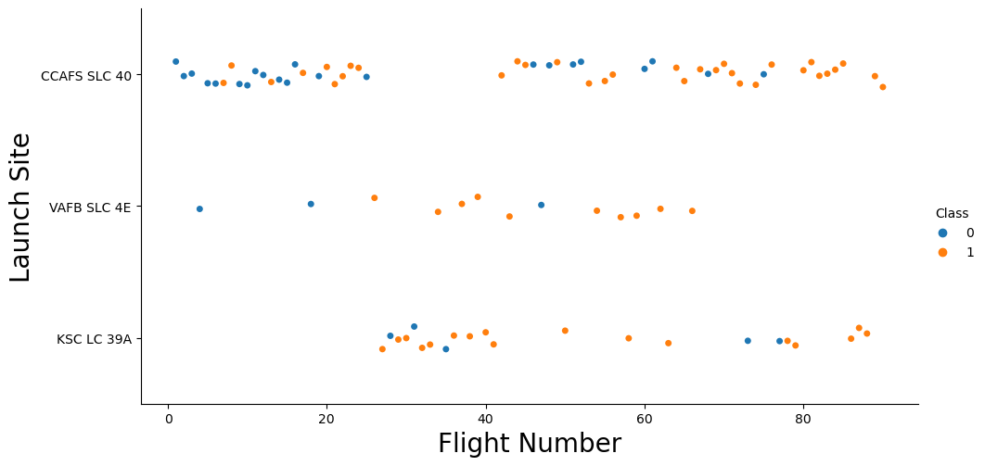
Flight Number vs. Launch Site
Insights from the plot
Earlier flights had a lower success rate (blue = fail).
Later flights had a higher success rate (orange = success)
CCAFS SLC 40 launch site has the most launches.
VAFB SLC 4E and KSC LC 39A have higher success rates.

Slide 18
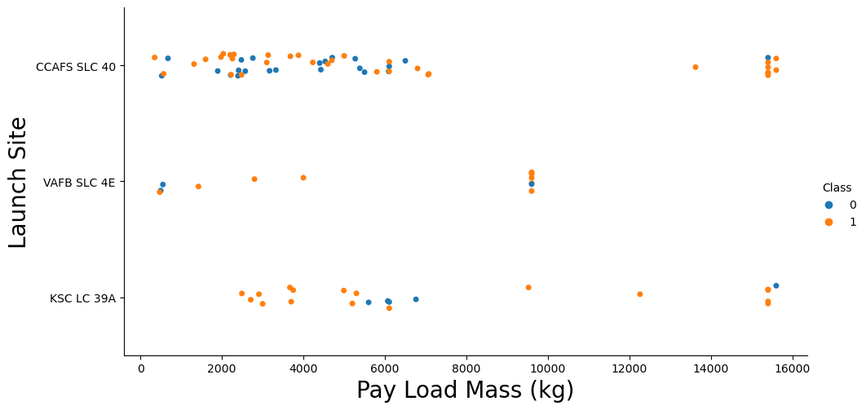
Payload vs. Launch Site
Insights from the plot
The heavier payload mass of launches seems to have a higher success rate.
KSC LC 39A has a 100% success rate for launches less than 5500 kg.
There is no clear correlation between payload mass and success rate.

Slide 19
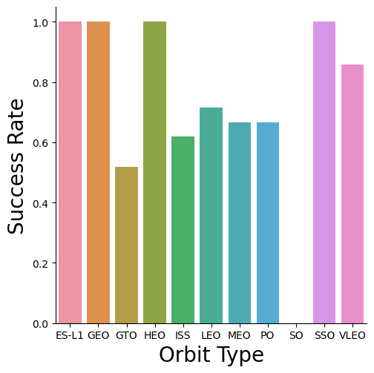
Success Rate vs. Orbit Type
Insights from the plot
100% success rate
ES-L1
GEO
HEO
SSO
0% Success Rate
SO

Slide 20
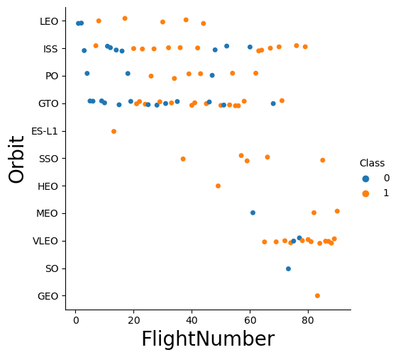
Flight Number vs. Orbit Type
Insights from the plot
The high success rate of the GEO, HEO, and ES-L1 orbits can be explained by only one flight into the respective orbits.
Generally, the success rate increases with the number of flights for each orbit.

Slide 21
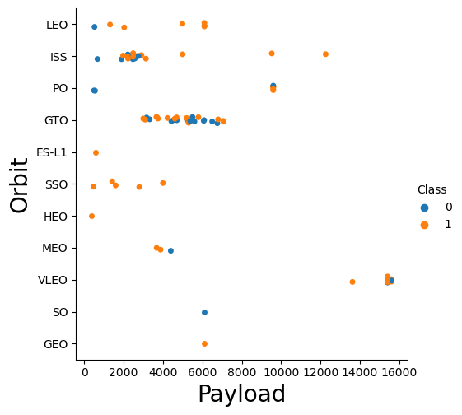
Payload vs. Orbit Type
Insights from the plot
Heavy payloads are better with LEO, ISS and PO orbits.
The GTO orbit has an unclear relationship between payload mass and success rate.

Slide 22
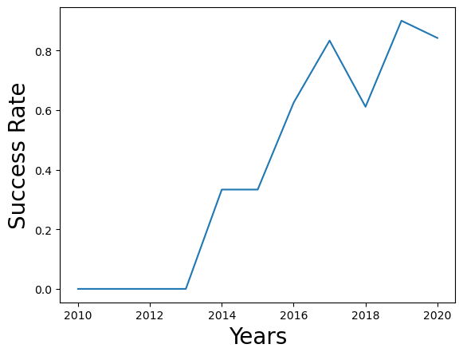
Launch Success Yearly Trend
Insights from the plot
No landings were successful from 2010 to 2013.
The success rate improved from 2013 to 2017 and 2018 to 2019.
The success rate decreased from 2017 to 2018 and 2019 to 2020.
The success rate has improved overall since 2013.

Slide 23
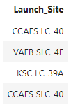
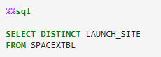
All Launch Site Names

Slide 24
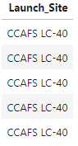
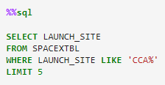
Launch Site Names Begin with 'CCA'

Slide 25
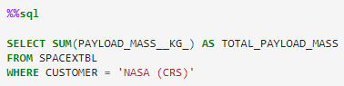
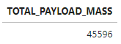
Total Payload Mass

Slide 26
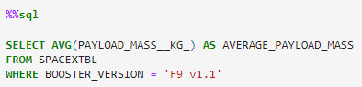
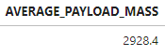
Average Payload Mass by F9 v1.1

Slide 27
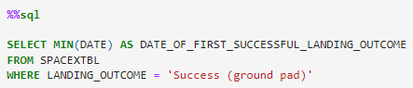
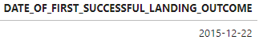
First Successful Ground Landing Date

Slide 28
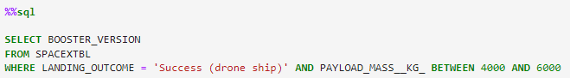
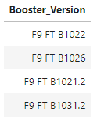
Successful Drone Ship Landing with Payload between 4000 and 6000

Slide 29
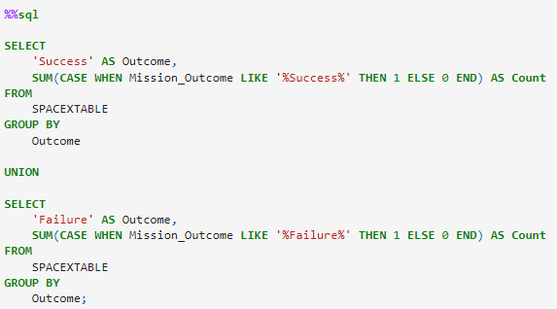
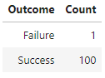
Total Number of Successful and Failure Mission Outcomes

Slide 30
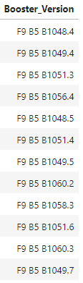
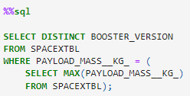
Boosters Carried Maximum Payload

Slide 31
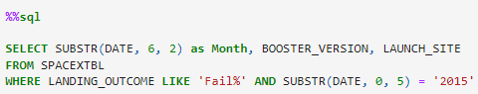
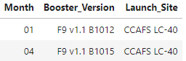
2015 Launch Records

Slide 32
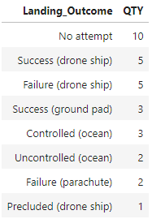
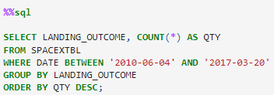
Rank Landing Outcomes Between 2010-06-04 and 2017-03-20

Slide 33

Section 3

Slide 34
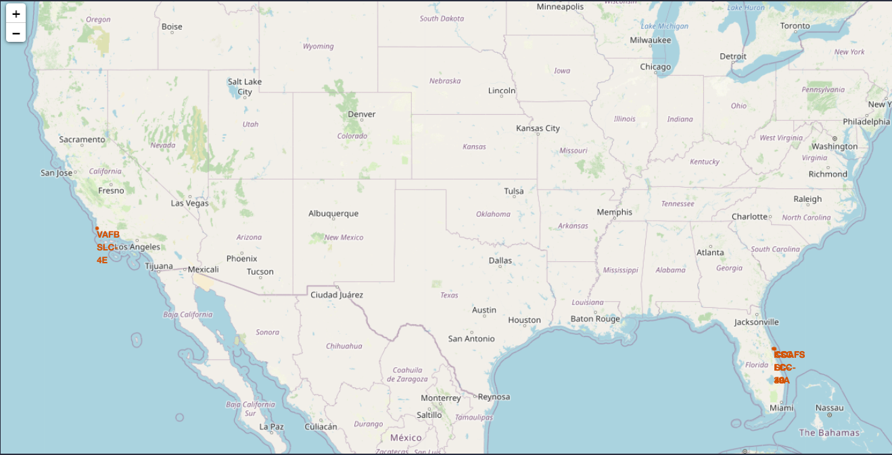
Launch Sites
All SpaceX launch sites are on the coasts of the United States of America.

Slide 35
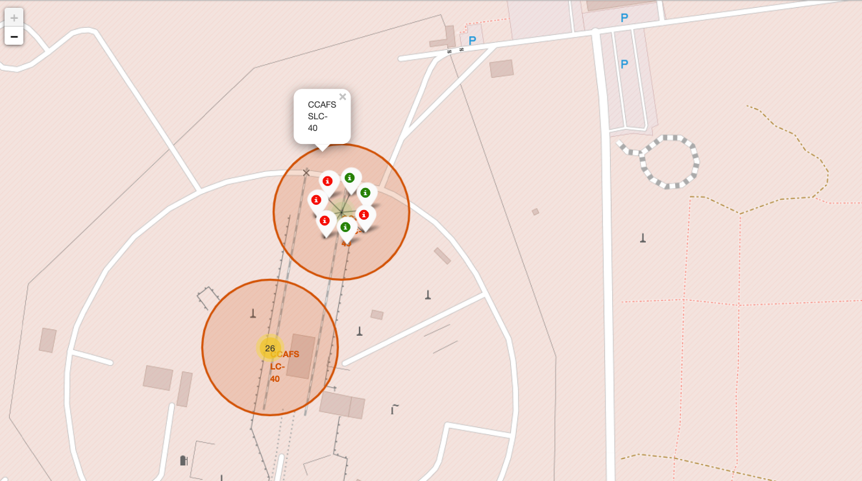
Launch Outcomes
Green markers for successful launches
Red markers for failed launches
Launch site CCAFS SLC-40 has a 42.9% success rate.

Slide 36

Distance to Proximities
For CCAFS SLC-40
0.90 km from the nearest coastline
21.96 km from the nearest railway
23.23 km from the nearest city
0.59 km from the nearest highway

Slide 37

Section 4

Slide 38
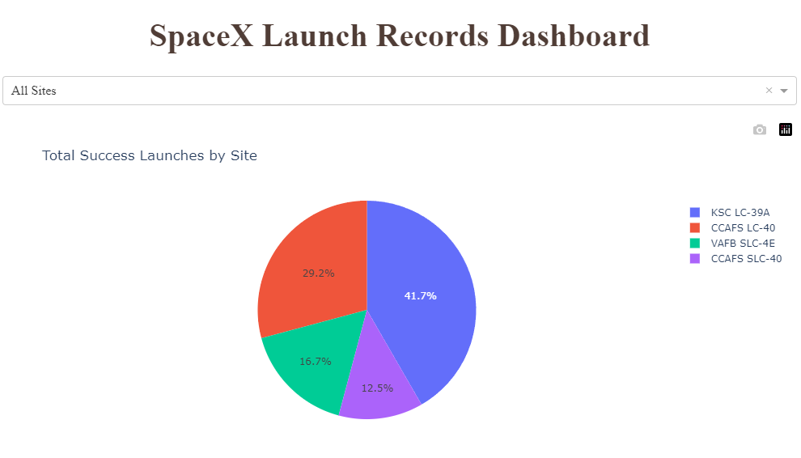
Launch Success by Site
The launch site KSC LC-39A had the most successful launches, with 41.7% of the total successful launches.

Slide 39
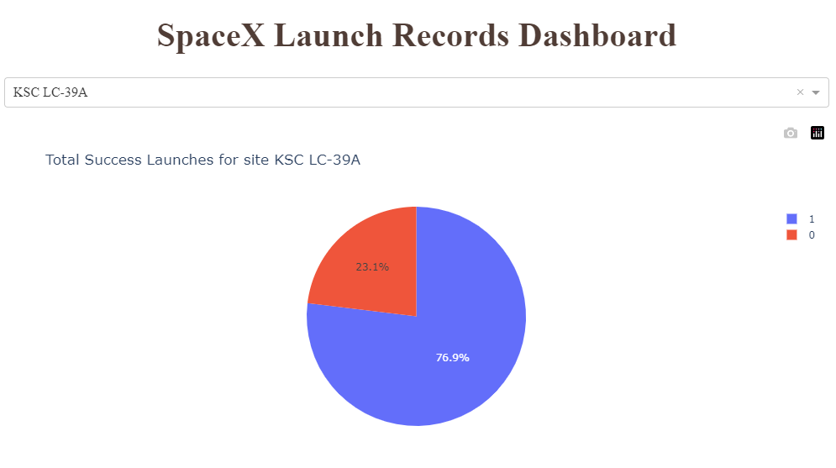
Launch Success for KSC LC-39A
KSC LC-39A has the highest success rate of successful launches, with a 76.9% success rate.

Slide 40
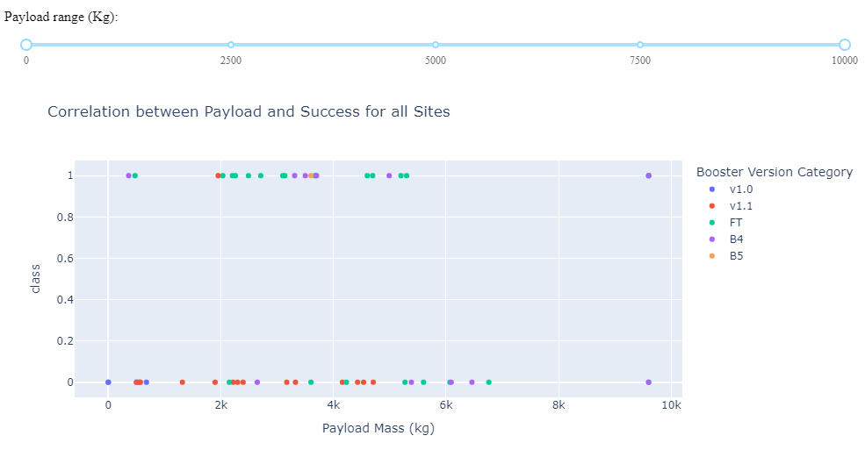
Payload VS. Launch Outcome
1 means success.
0 means failed.
Payloads between 2000 kg and 5000 kg have the highest success rate.

Slide 41

Section 5

Slide 42
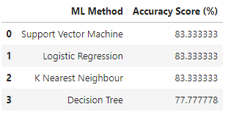
Classification Accuracy
The SVM, Logistic Regression, and KNN models performed at the same level and had the same accuracy score of 83.33%.
The Decision Tree model was outperformed and only achieved a score of 77.78%.

Slide 43
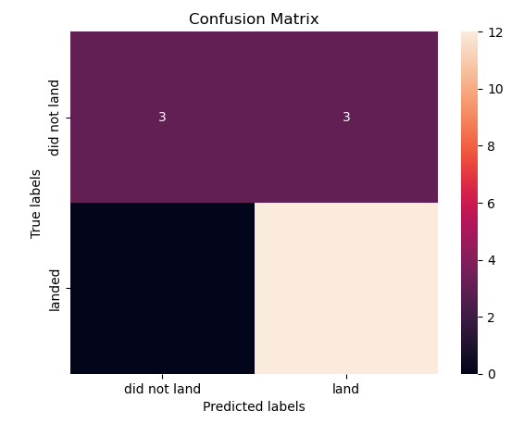
Confusion Matrix
Confusion Matrix Outputs
12 True Positive
3 True Negative
3 False Positive
0 False Negative

Slide 44
Conclusions
The SVM, Logistic Regression, and KNN models performed similarly on the test data, while the Decision Tree model performed slightly less.
All the launch sites are close to the coast.
Launch success rate increases over time.
KSC LC-39A has the highest success rate among launch sites. It has a 100% success rate for launches less than 5,500 kg.
Across all launch sites, the higher the payload mass (kg), the higher the success rate.

Slide 45


